Slide 1
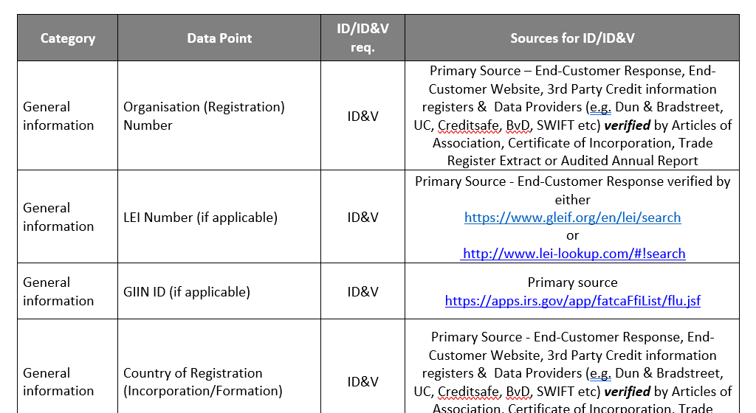


The Invidem KYC Data Standard
Confidential
~250 specific data points with predefined content and level of quality control
Categories:
  General information (organisation number, addresses,
  country of registration, etcetera)
  Business information (NACE/SNI codes, main industry,
  country of significant operations, etcetera)
  Financial information (source of wealth, total assets,
  total equity, name of regulator, etcetera)
  Ownership structure information (legal name and form,
  control percentage, bearer shares, etcetera)
  Beneficial owner information*
* Three calculation methods are used to find individuals who owns or controls, either directly or indirectly,
a shareholding of at least 25% plus one share or has an ownership interest of more than 25% in the end customer, including DOPs and certain associated parties and entities.

